Slide 1
2026 Approved Rules Review for NTOs

Slide 2
Medical Withdrawal Request (rule 6.3.2-.5)
6.3.2 - The Medical Withdrawal Request Form must be signed by the athlete and one of the following three categories of physician:
The team physician of the athlete
If the team submitting a Medical Withdrawal Request Form has an agreement to use the physician of another team
  that physician may sign the form
The LOC Chief Medical Doctor may do so
Notes:
Often confusing, and this just clarifies

Slide 3
Medical Withdrawal Request (rule 6.3.2-.5)
6.3.4- Medical Withdrawal Request forms must be submitted with 24hrs of the relevant event.
  However, if there is an acute injury or other relevant acute issue then that must be explained on the form if it is inside the 24hr time limit
The decision of the physician must be submitted in writing to the TD who then must communicate the decision to the athlete’s team!
Notes:
Often confusing, and this just clarifies

Slide 4
Rule 5: re-entry after changes in sport class
Athletes who are subject to re-entry may only be permitted to re-enter in their new Sport Class if the event is already available.
If the athlete cannot compete because their event is not available in their new Sport Class, then they may request that they be allowed to compete in different event in their new Sport Class.
If the classification team cannot assign a Sport Class to the athlete, they may assign a status of “classification not completed (CNC)”.
  If the athlete is assigned a status of CNC after observation in competition, then the athlete will receive a DQ for all events he/she participated in.

Slide 5
Failure to report to call room, rule 5.5.5
In a track and field competition, "RES" on a start list stands for Reserve.
If the RES athlete does not show up in the call room they should NOT be DQ’d
This means the athlete is currently an alternate or backup competitor for that event.
  They are not guaranteed a spot in the race or field but will be allowed to compete if
    one of the primary athletes withdraws,
    One of the primary athletes fails to show up and is DQ’d,
    or is disqualified before the event begins for another reason.

Slide 6
Athlete Bibs (rule 6.8)
6.8.4 These bibs must be worn as issued and may not be cut, folded or obscured in any way. It is prohibited to modify the bibs in any form, including by writing or adding on anything to the bibs.
In long distance events, the bibs may be perforated to assist the circulation of air, but the perforation must not be made on any of the lettering or numerals that appear on them.

Slide 7
Prosthesis (rule 6.12)
Athletes in Sport Classes T/F 61-64 (lower limb deficiency and leg length difference) must wear lower limb prosthetic device(s) in order to ensure both legs are balanced and to allow for symmetric movement during Competition.
These athletes MUST have their prosthetic device attached when they reach the nearer edge of the finish line
3. For athletes in Sport Classes T45-47 and F45-46 (upper arm deficiency or length difference) the use of upper limb prosthetic device(s) is optional.
  If the athlete choses to wear an upper limb prosthesis, he/she may choose to not wear one in a next round (i.e. semi-final, final)
  If the athlete is wearing a prosthesis at the start of the race, they must still have it attached as the reach the nearer edge of the finish line.

Slide 8
Assistance to Athletes (rule 7)
  7.3(b) Possession or use of video recorders, radios, CD, radio transmitters, mobile phones, or similar devices in the competition area which have the capacity to communicate Are Not Allowed!
  HOWEVER, smart watches have now been removed from the list! No clear evidence that they provide assistance on the field of play
  Authors comment: in our opinion, Smart Glasses should also fit into this category
    However smart glasses have not been included into the rule book since, like watches, there is no clear evidence of their use

Slide 9
Assistance to Athletes (rule 7)
  Rule 7.4(G) IT IS NOT ASSISTANCE when ambulatory athletes receive physical support from an official, or other person designated by the LOC, to recover to a standing position and continue the race.
The same holds true for wheelchair athletes receiving assistance by an official or other person designated by the LOC, to recover to an upright position and enable them to continue in the race or to access medical assistance.
Note that the assistance cannot advance the athlete beyond the point on the track where the incident occurred.

Slide 10
Assistance: Track & road events (rule 7.13)
  7.13.1 Some athletes in Sports T12, T20, T35-38, T40-47, T61-64 and T71-72 may require their starting blocks to be set for them by the Starter’s Assistant. The
  The Technical Delegate or TIC shall provide the appropriate athletes and/or their team coach, team assistant or team leader with a document on which to show their requirements.
7.13.2. The Technical Delegate may, upon written request by either the athlete, their team coach, team assistant or team leader, permit an athlete’s assistant to accompany the athlete on to the field of play to set the athlete’s starting block(s). The athlete’s assistant shall withdraw from the field of play prior to the start of the race.
7.13.2.1. An athlete’s assistant may accompany athletes in Sport Classes T71-T72 on to the field of play, to ensure the correct positioning of the athlete on the start line and/or to set the athlete’s starting block(s) only.
  For the avoidance of doubt, no written request to the Technical Delegate is required for such assistance. The assistant shall withdraw from the field of play prior to the start of the race.
  Note: the call room should be notified upon entry into the callroom that the assistant wants to accompany the athlete

Slide 11
Assistance: Track & road events (rule 7.13)
  7.13.3. To ensure a safe transfer for those athletes in Sport Class T12 who do not run with a guide-runner, an athlete’s assistant may accompany such athletes from the Call Room up to the field of play.
    For the avoidance of doubt, no written request to the Technical Delegate is required for such assistance. The assistant shall withdraw from the field of play prior to the start of the race.
  Note: the call room should be notified upon entry into the call room that the assistant wants to accompany the athlete
  Note2: the “assistant” may or may not actually be a guide but their role here is to assist the athlete in making it to their event (track or field)

Slide 12
Assistance to Athletes (rule 7.14)
  Note (ii): Technical Officials, accredited volunteers, and other personnel are not permitted to assist with transferring and/or strapping athletes to or from their throwing frame.
    If an assistant is unable to provide such assistance, additional assistance may be permitted by another accredited member of the athlete’s team, provided a request for such additional assistance is submitted in advance and approved by the Technical Delegate.
  Note (iii): After the athlete has been transferred to the throwing frame and strapping is completed, the assistant must withdraw from the throwing circle and the cage before each attempt, including warm-up trials, begin.
  Note (iv): The LOC shall provide distinctive vests to identify the assistants, that shall be distributed in the call room.

Slide 13
Rulings and Disqualification (rule 8.1)
  Bona Fide Participation, Unsporting and Improper Conduct
  Note (iv): If a yellow and/or red card is issued to a guiderunner or an assistant for unsporting or improper conduct, then the yellow and/or red card issued is also affects the respective athlete.

Slide 14
The Start (rule 17.1)
  Note (ii): A crouch start stance is not required by athletes in Sport Classes T35-38, T40-47 and T61-64.
Note(iii): It is acceptable for arm amputee athletes or those with short arms (T45,46,47) to use support pads on which to rest stumps at the start or to improve balance.
  Support pads may also be permitted for T61 athletes in races in which they intend to use a crouched start. (new rule)
  Support pads must be completely behind the start line and not interfere with any other athlete.
  Author comment: Other classes that are not mentioned here still do not have the right to use starting pads!
  Author comment2: it is up to the start team and start referee and call room referee to understand this modified rule so that no other athlete in a different class inadvertently uses support pads at the start!

Slide 15
Changes to Rule 17.5 affecting T61& T62 athletes in track events
The original 2026 rule Note to Rule 17.5 states that:
  “arm amputee athletes and athletes with short arms may use support pads on which to rest their stumps at the start or to improve their balance”.
    This is not a change and did not apply to lower extremity amputees
Now, the new provision that came into effect on 1 September
  allows athletes in Sport Class T61 (bilateral above the knee) to use support pads for stability when using a crouch start. i.e. bilateral above the knee amputee.
    This provision applies only to Sport Class T61,
    NOT T62 (bilateral BELOW the knee amputees) OR T63/T64 unilateral below the knee amputees!!

Slide 16
To summarize!
support pads may be used by:
  Arm amputee athletes and athletes with short arms; or
  Athletes in Sport Class T61 using a crouch start, under the new provision.
Being in Sport Class T62, T63 or T64 alone does not entitle an athlete to use a support pad.
  Athletes in these classes may use a support pad if they meet the conditions set out in the Note to Rule 17.5, (i.e. they also have an upper extremity deficiency) See example below and on the following slide
Example:
  An athlete in lane 8 of a T63/T42 race (unilateral below the knee with or without amputation) is eligible to use a support pad BECAUSE:
    He also has an upper limb deficiency affecting his left arm!
  Authors comment: It is up the the start team (starter, assistant, referee etc) to be fully aware of who can and who cannot use support pads!!!
Notes:
For illustration purposes, in the 100m T63 event at the Paris 2024 Paralympic Games, the athlete in lane 9 would not be eligible to use a support pad based on his T63 Sport Class alone. However, as he also has an upper limb deficiency affecting his left arm, he is eligible to use a support pad at the start if he wishes, in accordance with the Note to Rule 17.5.
Start team must be fully aware of this rule!!!!!!

Slide 17
T63/T42 100m; Paris 2024
  For illustration purposes, in the 100m T63 event at the Paris 2024 Paralympic Games, the athlete in lane 8 would not be eligible to use a support pad based on his T63 Sport Class alone.
    However, as he also has an upper limb deficiency (dysmelia, i.e. his arm is short and and abnormally developed) affecting his left arm, he is eligible to use a support pad at the start if he wishes, in accordance with the Note to Rule 17.5.

Slide 18
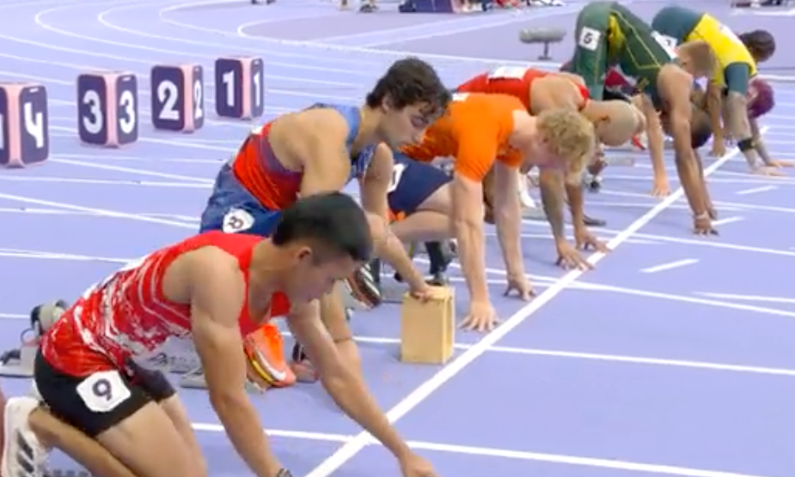
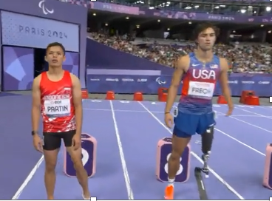
T63/T42 100m; Paris 2024
Lane8 athlete
Lane 8
T63 with disfigured and shortened left arm in lane 8

Slide 19
The Race (rule 18)
  Rule 18.5(C): In all races run in lanes (or any part of a race run in lanes), each athlete or the athlete’s guide runner shall keep within their allocated lane from start to finish and:
    when running on a bend, shall not step or run on or inside the left-hand lane line or in the case of the inside lane, the kerb or line marking the border of the inside of the track;
    For wheelchairs, If 1 wheel is on the line the athlete has two pushes to get off before being DQ’d
    For Frame Runners, if 1 wheel is on the line the athlete has Two STEPS to get off before being DQ’d
    For either above if a wheel goes completely over the inside line of the lane it is automatically a DQ
  Rule 18.5(D): In all races not run in lanes (or any part of races not run in lanes), steps/wheels once on or completely over the kerb or line marking the applicable border :
    The consequences are the same as elucidated in items 2, 3, 4 above

Slide 20
The Race (rule 18.18)
  An athlete and/or guide-runner may carry water, refreshments or sponges by hand or attached to their body provided such items are (i) carried from the start of the race; or (ii) collected from an official station during the race.
    Such items may be exchanged between an athlete and their guide-runner (or vice versa) at any time during the race.
    In addition, such items may be provided to athletes and/or guide runners for medical reasons,
      medical staff member appointed by WPA and/or LOC or at the direction of race officials.
      An athlete and/or guide runner who breaches this Rule shall:
        for a first such offence, be warned by the Referee, normally by showing a yellow card.
        For a second offence, the Referee shall disqualify the athlete and/or guide runner, normally by showing a red card.

Slide 21
The Finish (rule 19)
  Comment: At the completion of all Wheelchair and Frame Running races, some athletes tend to continue wheeling and/or running straight after crossing the finish line, rather than following the curve of the track. This can lead to potential collisions with other athletes. To prevent such incidents, all athletes should follow the curve of the lanes after finishing their race.

Slide 22
Long Jump (rule 28)
  Rule 28.1:
  Comment: Since the intent of Rule 28.1a focuses on the position of the front of the take-off shoe / foot or prosthetic device, it is not relevant if the vertical plane should be broken in other ways, for example,
    by their hands or arms or a cap or piece of jewelry falling from the athlete’s body during the take-off.
    Similarly, a loose shoelace or the like is not relevant to the adjudication even if it breaks the plane.

Slide 23
Discus Throw (rule 32)
  32.5.1. The cage should be U-shaped in plan as shown in Figure 18. The width of the mouth should be 6m, positioned 7m in front of the centre of the throwing circle.
    The end points of the 6m wide mouth shall be the inner edge of the cage netting.
    Provisions must be made in the design and construction of the cage to prevent a discus from forcing its way through any joints in the cage, the netting, underneath the netting panels or draped netting.
  32.5.2. The netting panels or draped netting must be fixed in a way that the width of the mouth is the same at each height of the netting.
    The height of the netting panels or draped netting at their lowest point should be at least 4m,
    progressively increasing towards the front of the cage to a height of at least 6m for the 3m nearest the front of the cage on each side.

Slide 24
Throwing Frame Specifications (rule 35.1(h))
  New Rule 35.1h in force from 1 January 2027
  h) Only athletes in Sport classes F31 and F51 may use a daily wheelchair as their throwing frame, which must not move during the throwing action.
  Note: Strapping across the upper thighs and or pelvis is encouraged.
    Strapping must be only to the daily wheelchair with non-elastic material.
    Such strapping shall be the responsibility of the athletes’ assistant and included within the time permitted in Rule 35.5 b).

Slide 25
The Club (Rule 37)
  Construction. The Club shall consist of four main parts: a head, a neck, a body and an end. The head, neck and body shall be solid and made of wood so as to constitute a fixed and integrated whole. The body shall have fixed it to a cylindrical end constructed of metal without indentations, projections or sharp edges.
  The surface of the head, neck and body shall be smooth and have no dimples or pimples, grooves or ridges, holes or roughness.
  The head shall be spherical or cylindrical in shape and immediately taper towards the neck.
  The diameter of the widest part of the body shall not exceed 60mm and may be cylindrical. The club shall taper regularly towards the neck and slightly towards the metal end.
  The shape of the Club must be as shown in Figure 24. It shall conform to the following shape and specifications:

Slide 26
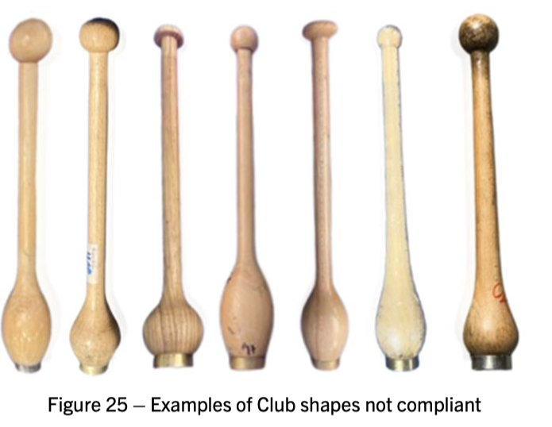
The Club

Slide 27
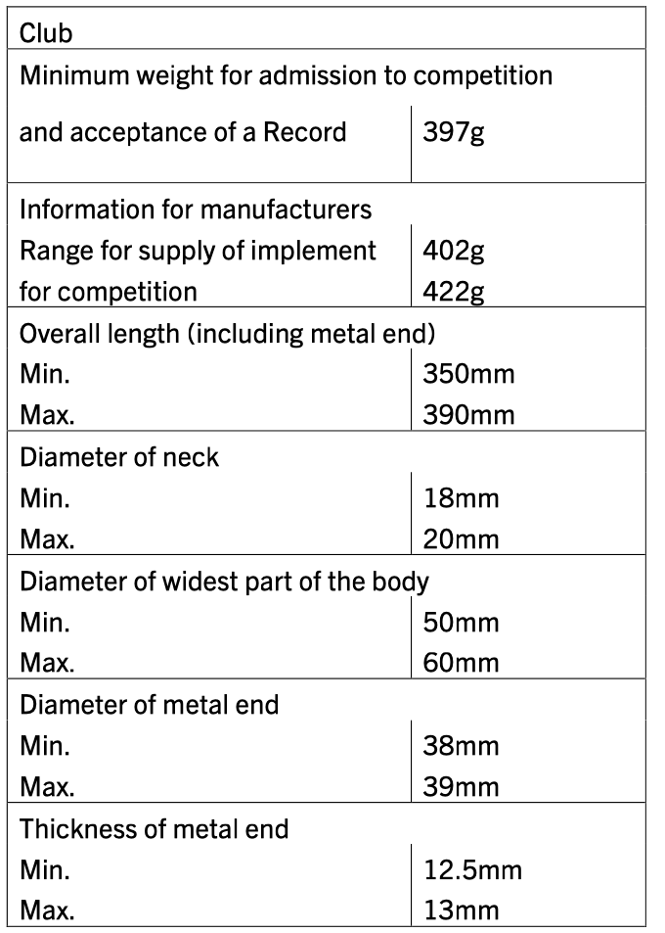
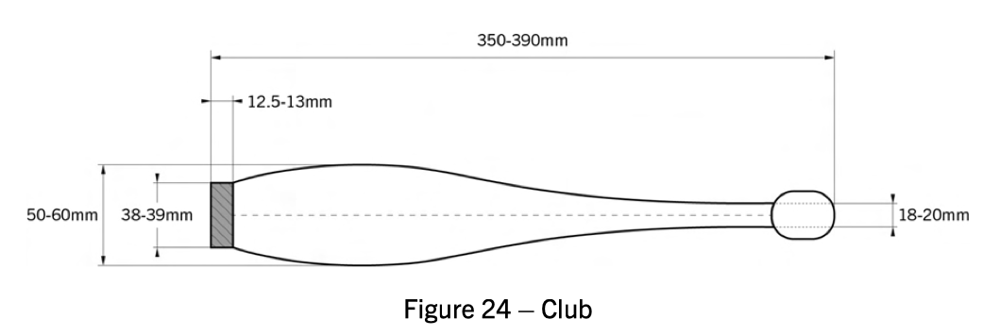
The Club (Rule 37)
Notes:
Note: a new rule will be forth coming! Assessment will include descriptions of the balance point of the center of mass of the club.

Slide 28
The End, Thank You!!
  QUESTIONS???????

